Slide 1
DataNavigator® - Workshop Web Client Tools
Amber Puranen, Business Analyst
Denise Vielehr, Business Systems Analyst
January 2019

Slide 2
DataNavigator® Web Client Tools
Contents
Overview
Getting Started
Transaction Search
Research List
Compare This Transaction
Custom Views/Grids Overview
Custom Grids
Custom Views
Favorites
Exporting Data
Research Tips
2

Slide 3
DataNavigator® Web Client Tools Overview
There are several tools that can be used to aid investigating a problem transaction. These tools, combined with over 30 search criteria, can quickly locate and display key details of the transaction or exception (case) history.
Tool | Description
Research List | Used in Transaction Research to set aside one or more transactions to review.
Compare This Transaction | Used in Transaction Research to determine similarities or differences. Useful for locating dispute transactions.
Custom Views | A user can create custom views* as a quick view of data prior to selecting detail view. Columnar format allows grouping by field type.
Custom Grids | A user can create custom grids* as a quick view of groups of transactions prior to selecting detail view. *Note: Up to 6 custom views and/or grids are allowed.
3

Slide 4
DataNavigator® Web Client Tools Overview
Tool | Description
Favorites | Used to save frequently used search criteria. Favorite definitions are defined by user and will be saved until deleted by the user. All search criteria, except the PAN may be used as favorites.
Exporting Data | Ability to create an extract of the search results for supporting documentation or to perform additional calculations or sorting.
4

Slide 5

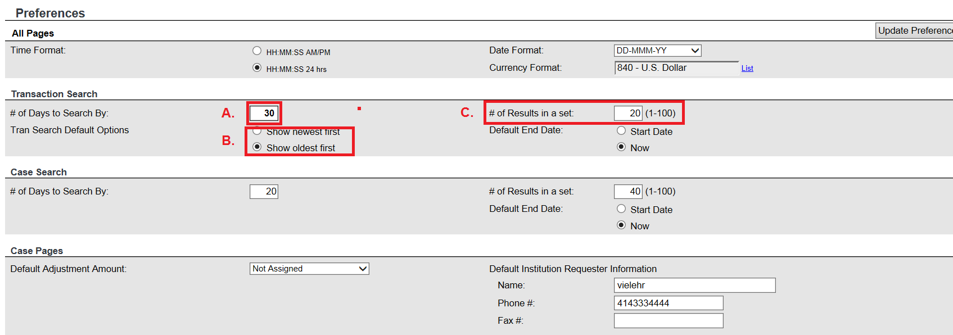
DataNavigator® Web Client Tools Preferences
Search screens can be customized by changing:
The date range to view transactions using the “# days to search by”
To search the newest transactions first or oldest
C. The number of transactions per page by setting “# results in a set”

Slide 6
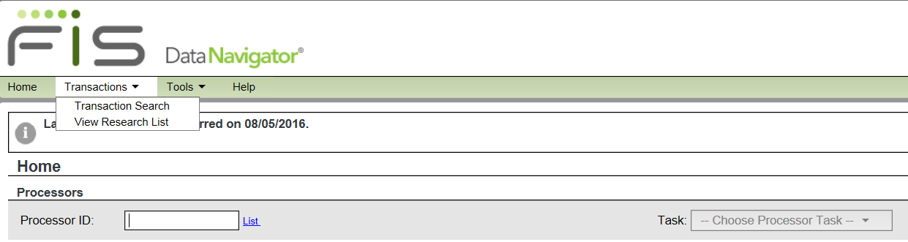
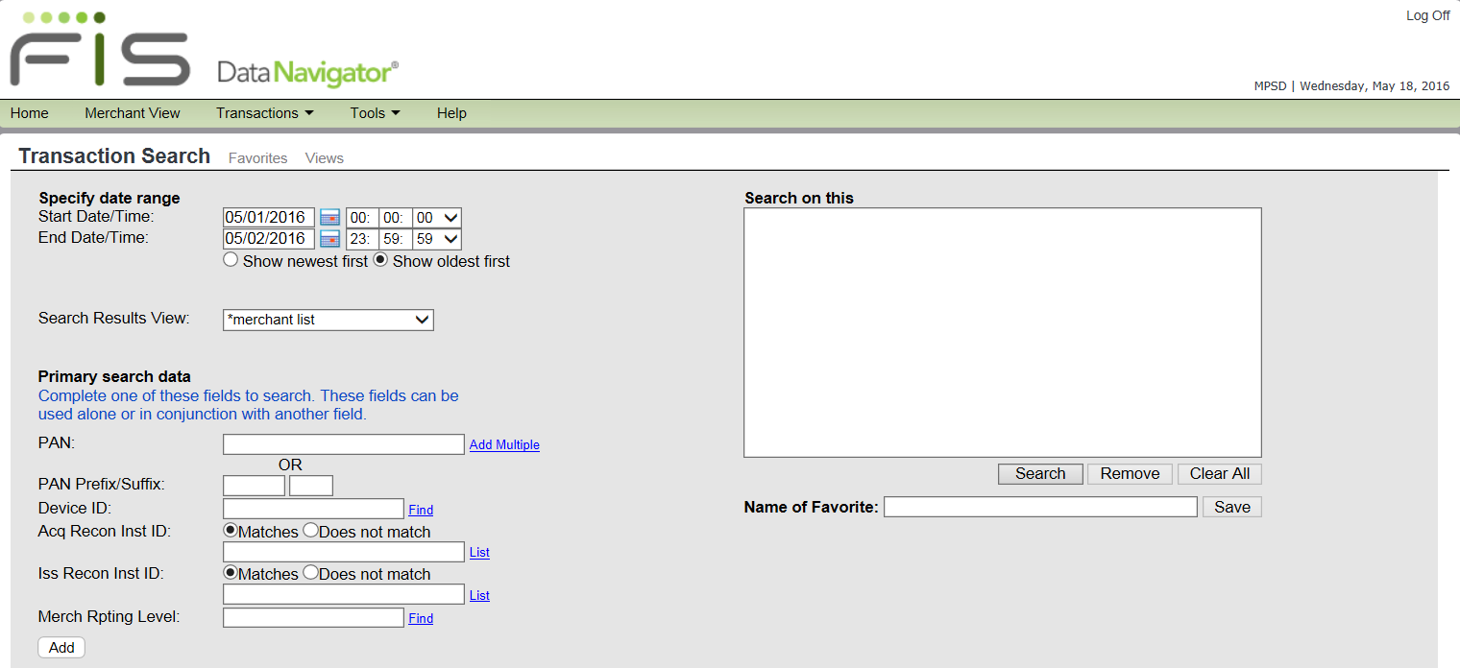
DataNavigator® Web Client Tools Transaction Research
Once logged on, from the Home page, use the menu bar to navigate to Transaction Search.

Slide 7
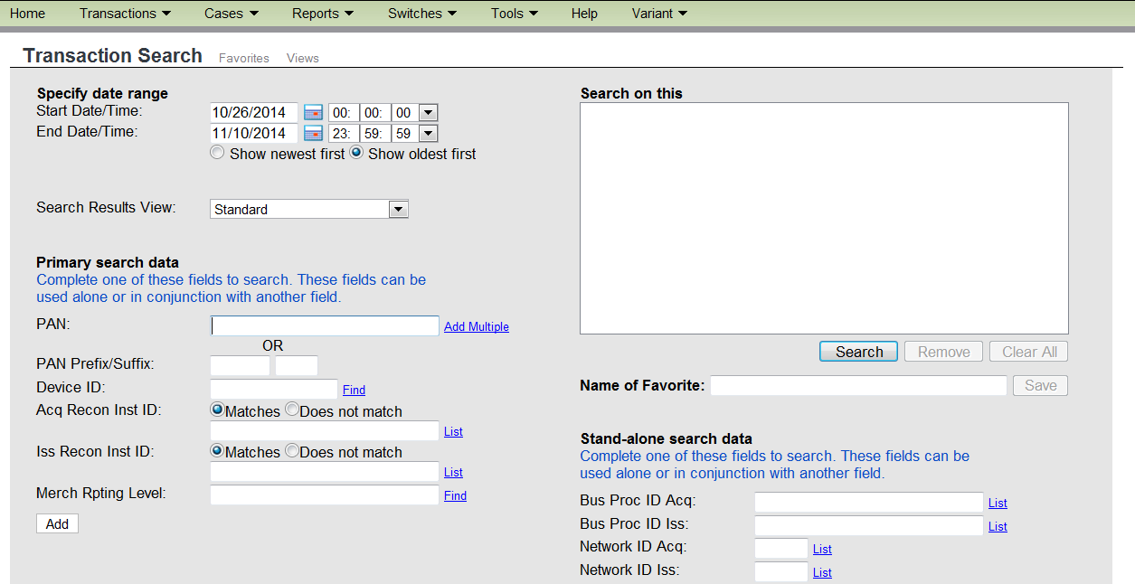
DataNavigator® Web Client Tools Transaction Research – Primary Search Criteria
Primary Search Data
The Start Date/Time and End Date/Time
PAN - enter the entire card number or PAN prefix (NNNNNN*).
Add Multiples: a link to enter more than one full PAN.
PAN Prefix/Suffix – The first six digits and last four digits of the card number.
Device ID - Device (ATM or POS)
Note: In partial PAN search only one partial Pan can be used at a time.
6. Acq Recon Inst ID - institution to which the transaction is reconciled.
Iss Recon Inst ID - Identifies the institution to which this transaction is reconciled and settled.
Matches – inst is acquiring or issuing recon inst.
Does not match – inst is not acquirer or issuing recon inst.
8. Merch Rpting Level - Identifies merchant or institution ID defined as the primary entity for totals management.
7

Slide 8
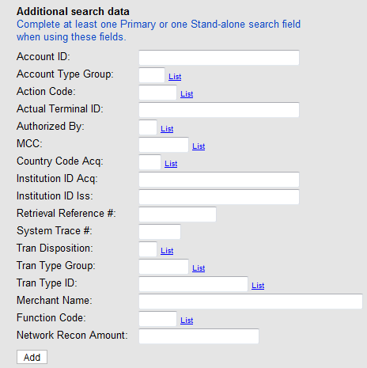
DataNavigator® Web Client Tools
Transaction Research - Additional Search Data
1. Account ID - Customer account
2. Account Type Group - A code for a group of account types.
3. Action Code - The response, approved or denied, returned by the authorizing network
Actual Terminal ID A unique# to the terminal owner identifying the actual terminal used for this transaction.
5. Authorized By – The list of authorizers who are permitted to authorize the transaction.
MCC – The list of merchant category codes.
Country Code Acq - Country of acquirer.
Institution ID
Acq: The institution that acquired the transaction.
Iss: The institution that holds the cardholder's account.
9. Retrieval Reference # - The local sequence number
10. System Trace # - The switch terminal sequence #
11. Transaction Disposition - Transaction was authorized, denied, disputed or reversed.
12. Tran Type Group - A user-defined description for a group of transaction types (based on Function Type).
13. Tran Type ID - Indicates the transaction type.
14. Merchant Name – The name of the merchant where the transaction has taken place.
Function Code - A code that further defines the transaction message
Network Recon Amount – amount transferred between issuer and acquirer.
8

Slide 9
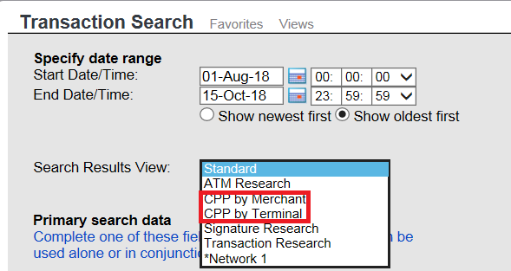
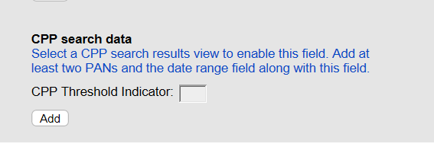
DataNavigator® Web Client Tools Transaction Research – Additional Search con’t
CPP Search Data
CPP Search Data is used to help identify a possible common point of purchase (CPP) from your list of compromised PANs.
CPP Threshold Indicator
Indicates the number of cards needed to consider a terminal or merchant as a possible point of compromise. The default value is two.
The CPP Threshold Indicator field is enabled only if you choose either the CPP by Merchant or the CPP by Terminal option from the Search Results View drop-down list.
9

Slide 10
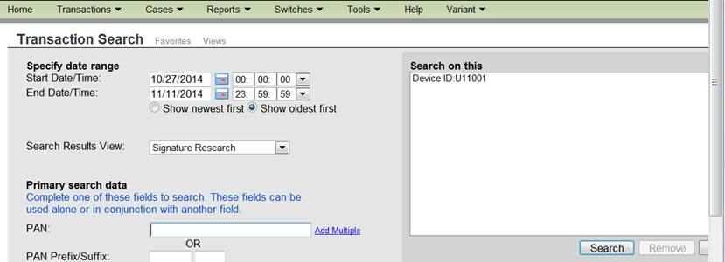
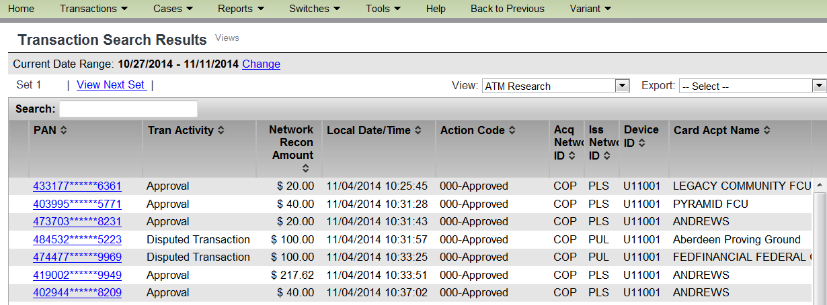
DataNavigator® Web Client Tools
Transaction Search Results
The list of transactions is returned based on the search criteria.
The Date/Time range can be modified for the next transaction search.
User Profile determines the access to the networks: ‘PLS’ issuing network.
10

Slide 11
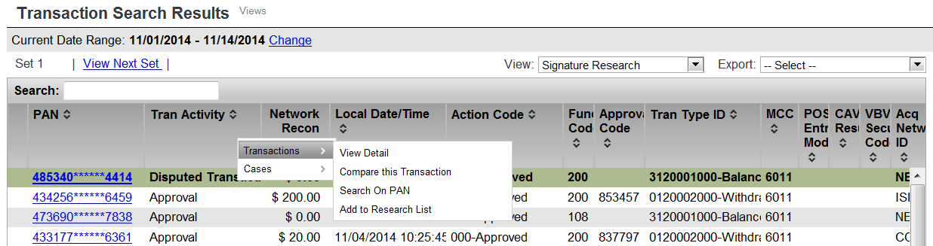
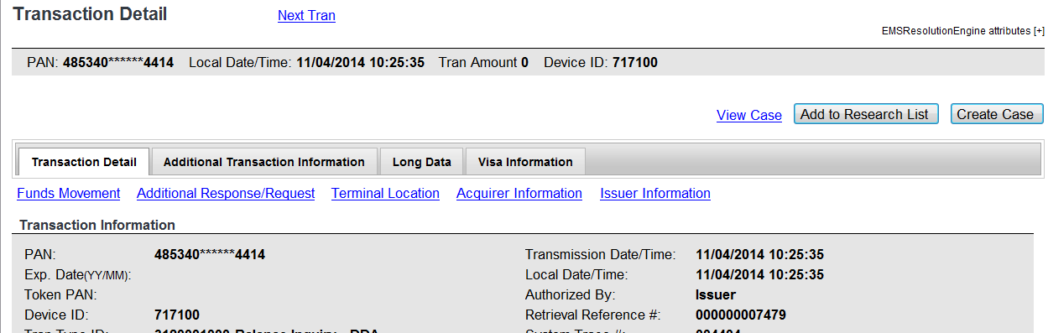
DataNavigator® Web Client Tools Research List
Right click
Click
The research list can be built from:
Transaction Search Results – right-click on desired transaction to get menu options and select ‘Add to Research List’.
Transaction Details – click on ‘Add to Research List’
11

Slide 12
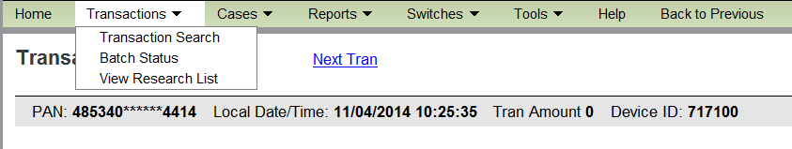
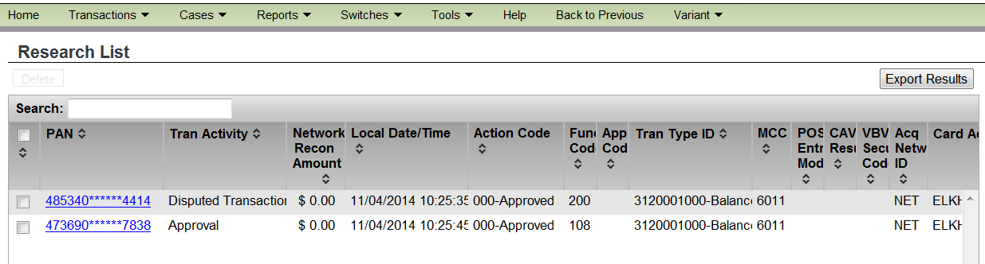
DataNavigator® Web Client Tools Research List
Select ‘View Research List’ from menu.
Selected transactions are display using last used transaction view.
List can be exported and printed for later use.
List is refreshed at each logon.
12

Slide 13
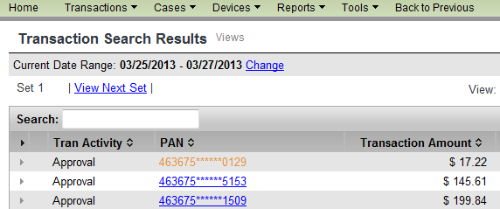
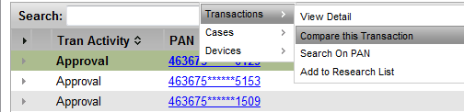
DataNavigator® Web Client Tools Compare This Transaction
Note: Comparing transactions can be done in any view.
Right click
1. From the list of transactions, right click on the first transaction you want to compare.
2A. Select
2B. Select
2. Select Transactions, then Compare this Transaction.
3. Repeat Steps 1 and 2 for a second transaction.
(Note: Up to 10 transactions can be compared.)
13

Slide 14

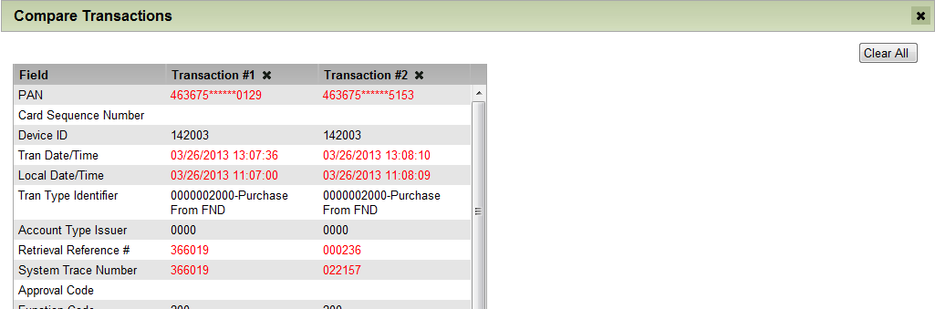
DataNavigator® Web Client Tools Compare This Transaction
Click
4. Click Compare.
View
5. View the comparison.
14

Slide 15
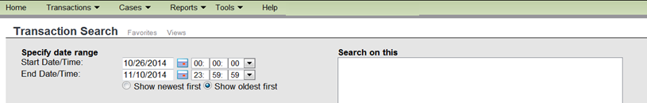
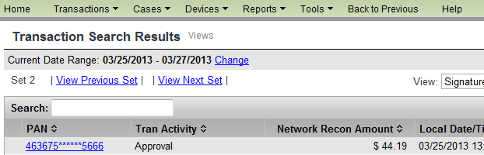
DataNavigator® Web Client Tools Custom Views/Grids
A user can create up to a combination of 6 custom grids or views.
Pre-defined grids and views cannot be edited.
Customized grids and views can be edited.
The “Views” function can be accessed from the Transaction Research Menu or Results screens.
15

Slide 16
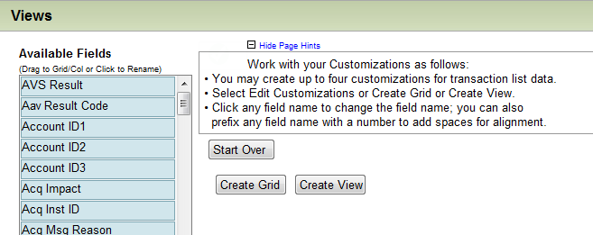
DataNavigator® Web Client Tools Custom Views/Grids
Click
1. On the Transaction Search Result screen, click the Views link.
Click
2. Optionally click the “+” to display Page Hints.
16

Slide 17

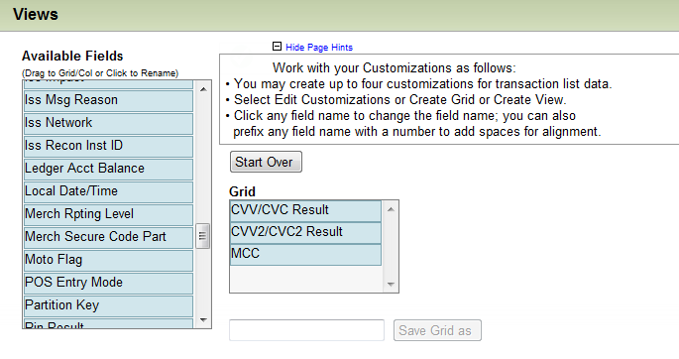
DataNavigator® Web Client Tools Custom Grid Feature
Click
3. After reading the instructions, click Create Grid.
Click
and
drag
4. Click and drag Available Fields into the Grid area.
17

Slide 18

DataNavigator® Web Client Tools Custom Grid Feature
5. Enter a name for the new grid, then click Save Grid as.
5A. Enter
5B. Click
18

Slide 19
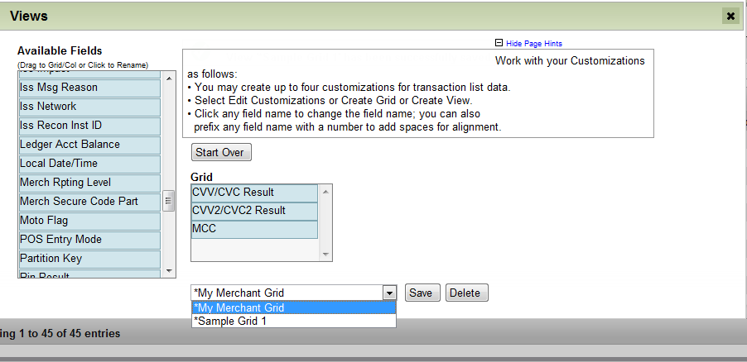
DataNavigator® Web Client Tools Custom Grid Feature
View
6. Use the pull-down menu to verify that the new grid was added.
19

Slide 20
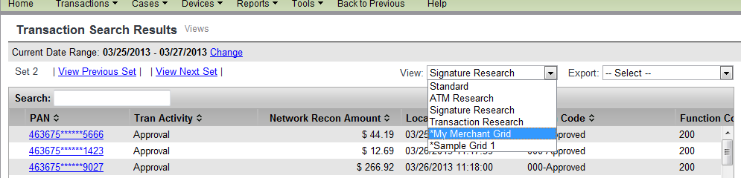
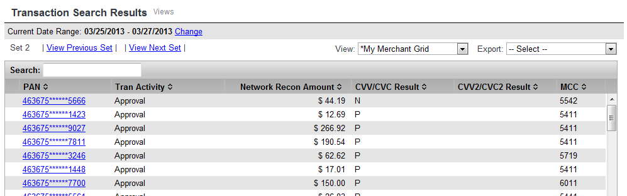
DataNavigator® Web Client Tools Custom Grid Feature
Click
7. Select the newly created grid.
8. Transaction information is displayed in the new format.
20

Slide 21
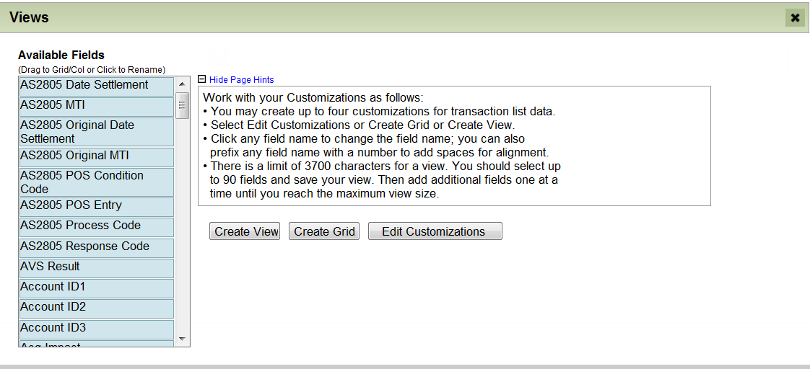
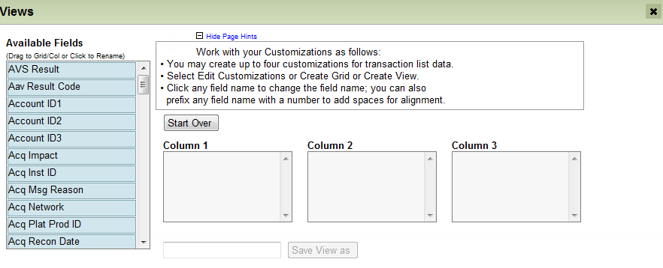
DataNavigator® Web Client Tools Custom View Feature
Click
1. From the Views screen, the views menu is displayed.
2. After reading the instructions, click Create View.
21

Slide 22
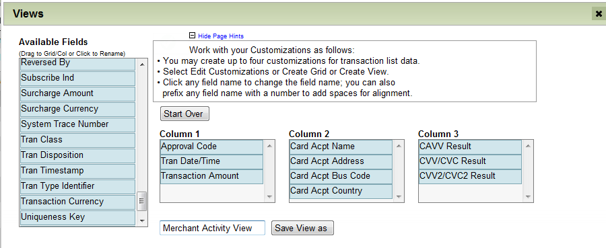
DataNavigator® Web Client Tools Custom View Feature
4A. Select a field from here
4B. Drag the field here
5A. Enter
5B. Click
3. Drag a field into a Column. Repeat the process as needed.
4. Enter a name for the View, then click Save View as.
22

Slide 23
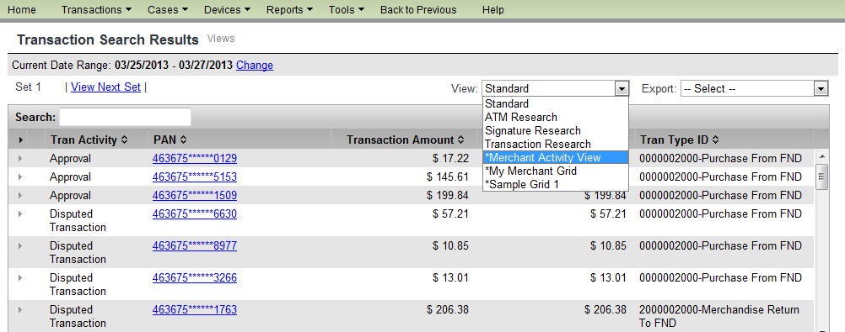
DataNavigator® Web Client Tools Custom View Feature
Select
5. From the View menu, select the newly created view.
23

Slide 24
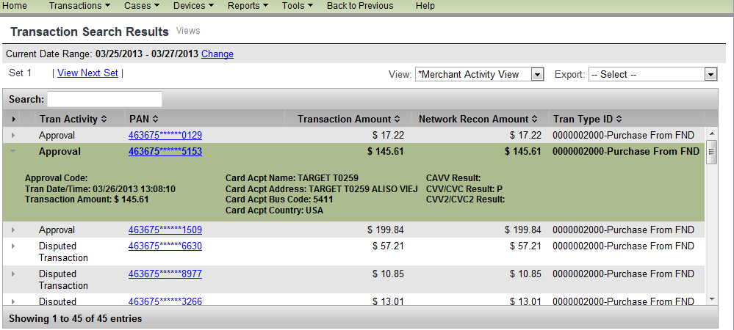
DataNavigator® Web Client Tools Custom View Feature
Transaction information is displayed in the new column format.
24

Slide 25
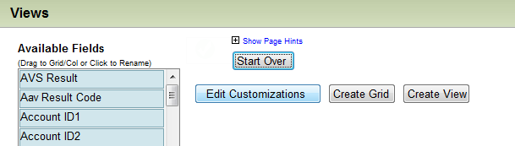
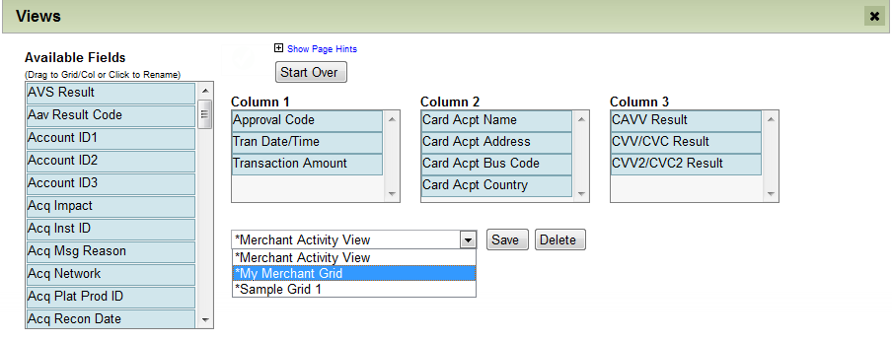
DataNavigator® Web Client Tools Editing a Custom View
Click
1. From the Views tab click Edit Customizations.
Select
2. From the pull-down menu select the View to be modified.
25

Slide 26
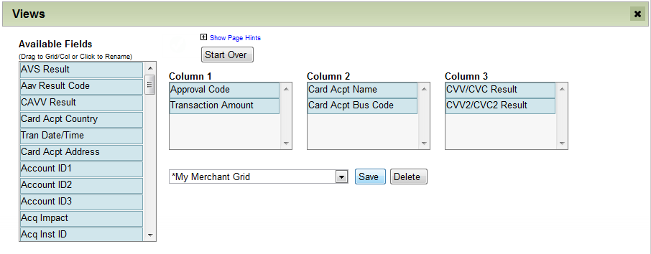
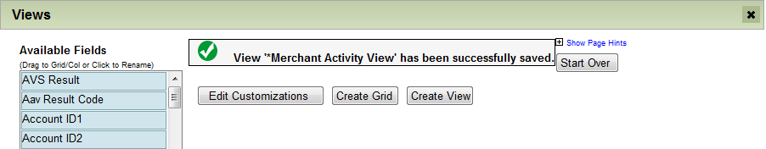
DataNavigator® Web Client Tools Editing a Custom View
4A. Modify
4B. Click
3. Alter the grid, then click Save.
The modified view has been saved.
26

Slide 27
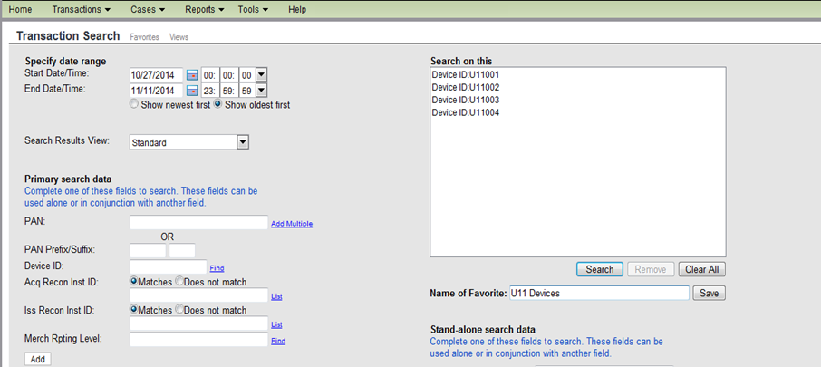
DataNavigator® Web Client Tools Favorites Link
Selected Criteria
Select search criteria
Enter a name for this favorite and click Save.
Note: PANs or partial PANs cannot be saved as a favorite.
27

Slide 28
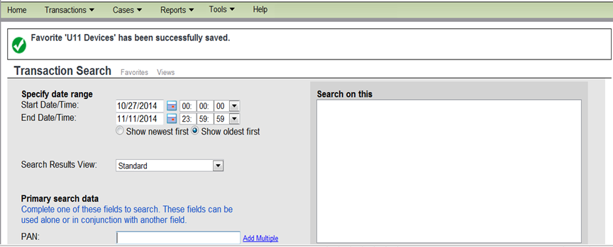
DataNavigator® Web Client Tools Favorites Link
Verify
Click Favorites link.
3. Verify the favorite view has been saved.
4. To view your choices, click Favorites.
28

Slide 29
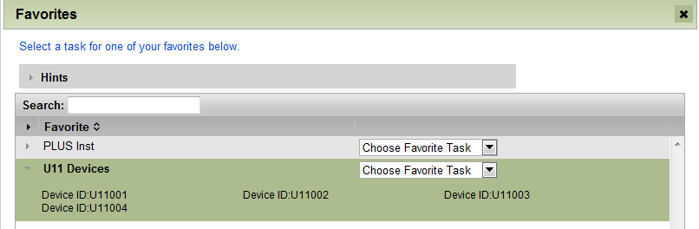
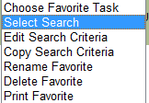
DataNavigator® Web Client Tools Favorites Link
Click
Click
View criteria in Favorites
Click ‘arrow’ to view criteria list
7. Click “Select Search” from the Task menu
29

Slide 30
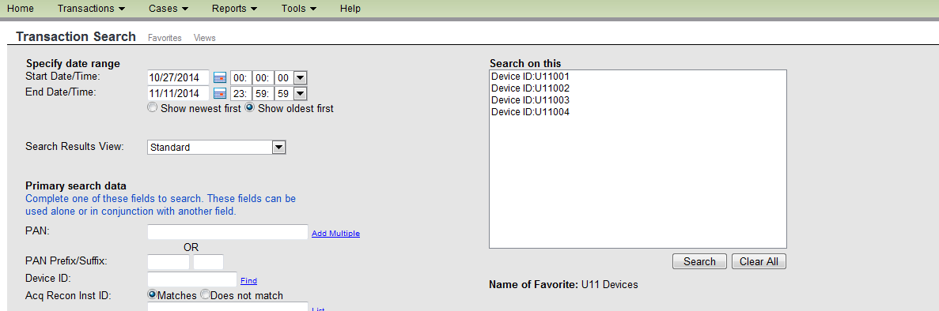
DataNavigator® Web Client Tools Favorites Link
8. Click Search.
Note: Additional criteria may also be added at this time.
30

Slide 31
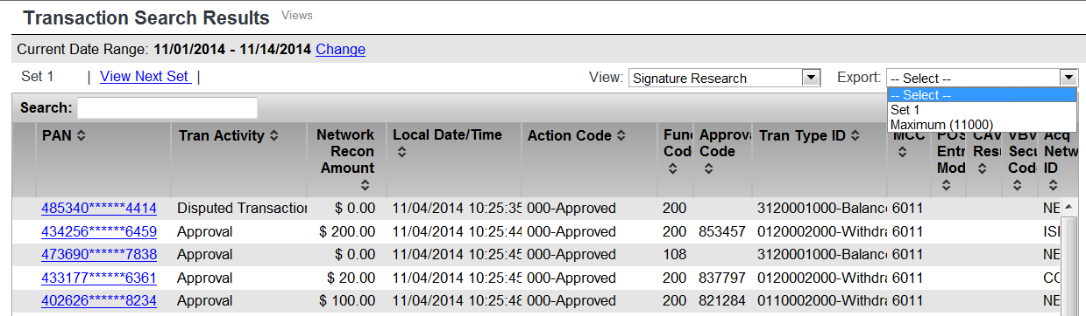
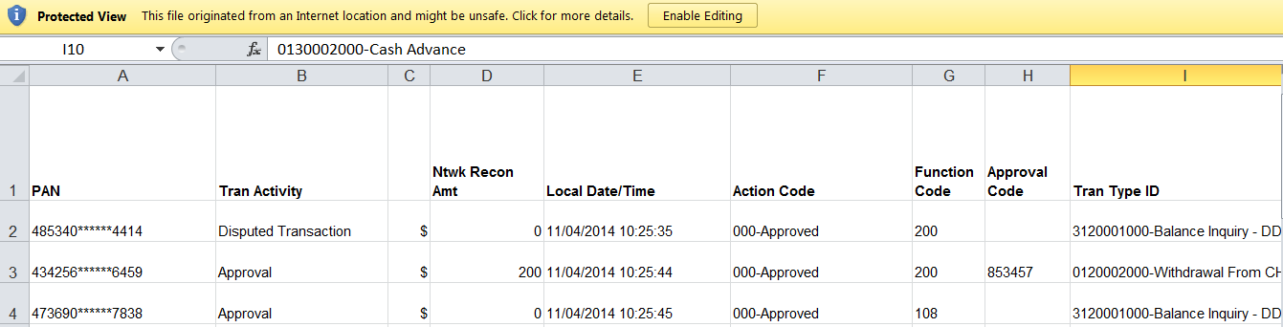
DataNavigator® Web Client Tools Exporting Data
Click
The list of transactions up to 11,000 transactions is returned. If more transactions, an informational message displays with further instructions.
The spreadsheet displayed can be exported saved to the user’s personal computer or printed for later use.
31

Slide 32
DataNavigator Tools Research Tips
Listed below are tips for improving the response time of your searches:
Limit the scope of your query by using specific values in the Primary Search Criteria or Primary Selections fields.
Specify as much of the PAN as possible.
Specify as short a range as possible in the Start Date/Time and End Date/Time fields, especially when performing searches using Device ID, Issuer Recon Inst ID, or pseudo (intercept) terminals.
Queries on more recent transactions or cases will be quicker than queries on older data.
32

Slide 33
Copyright © 2018 by FIS All Rights Reserved
This document is intended only for the use of FIS Corporation customers in connection with the products and services FIS Corporation has authorized. Any other use is not authorized.

